Slide 1
Green Business Application
Milestone 4 Report
Tai Ngoc Bui

Slide 2
Update Progress
Completed:
Develop Python script to format data to smoothing insertion process into database
Database is hosted by Amazon Web Services. A connection between database and my script has been established using Express.
Individual profile page has been completed
The CERTIFICATE table has been dropped and a new certificate column is added into BUSINESS table
Complete an aggregate page to display all companies and link it to the profile page
Complete search query using LIKE SQL command

Slide 3
Data Dictionary
Table Name | Attribute | Contents | Type | Format | Required | PK
BUSINESS | BUS_ID | Business ID code | NUMERIC | 999 | Y | PK
 | BUS_CATEGORY | Business Category | VARCHAR(20) | Xxxxx | Y
 | BUS_NAME | Name of business | VARCHAR(100) | Xxxxx | Y
 | BUS_ADDRESS | Business street address | VARCHAR(100) | Xxxxx | Y
 | BUS_CITY | Business city location | VARCHAR(20) | Xxxxx | Y
 | BUS_ZIP | Zip Code of the business | VARCHAR(20) | Xxxxx | Y
 | BUS_CONTACT | Business phone number | VARCHAR(15) | (xxx)-xxxx | Y
 | BUS_DESCRIPTION | Business detail | VARCHAR(200) | Xxxxx | Y
 | BUS_LOGO | The link to logo file | VARCHAR(100) | Xxxxx | Y
 | BUS_CERT | The link to pdf certificates | VARCHAR(100) | Xxxxx | Y

Slide 4
Current Schedule and Sprints
11/04/2019 - 11/12/2019 | Scrape all necessary data from official website http://greenbusiness.hawaii.gov/ Develop mockup for the page and ERD diagram
11/13/2019 - 11/18/2019 | Redesign Database model Develop script to import data into database Research on using AWS to host database
11/19/2019 - 11/25/2019 | Complete script to format SQL commands for importing data as well as editing tables Complete database hosting by AWS Complete individual profile page
11/26/2019 - 12/06/2019 | Complete aggregate page listing all companies Complete search query using LIKE SQL command Complete individual profile page

Slide 5
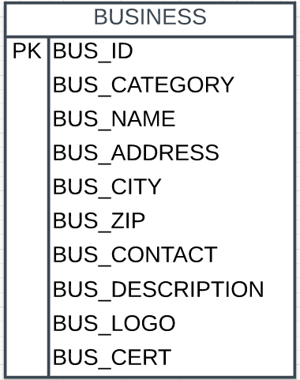
Entity Relational Diagram

Slide 6
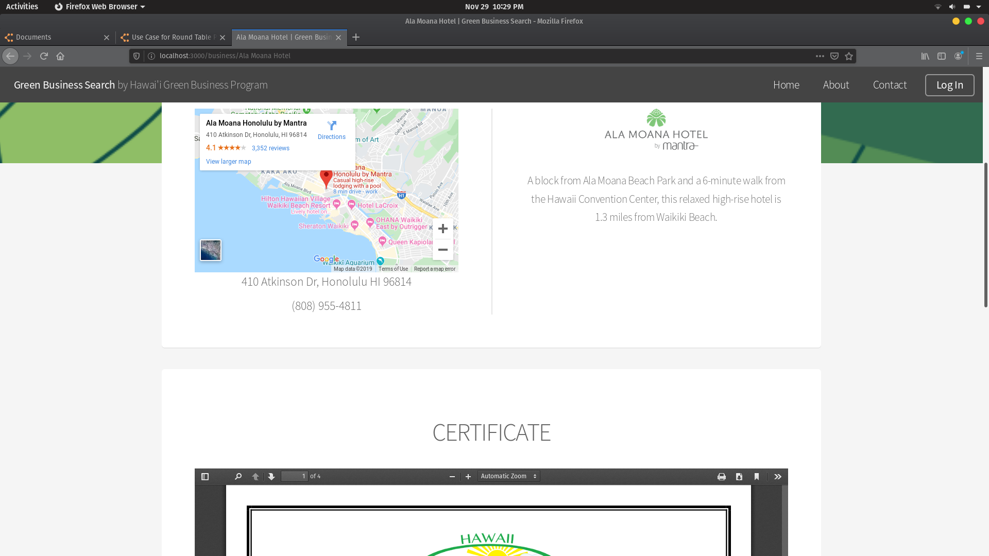
Profile Page

Slide 7
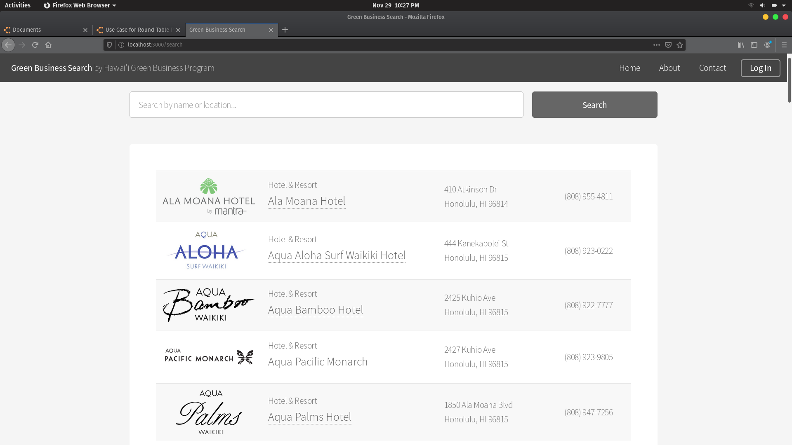
Aggregate Search Page

Slide 8
Mahalo Nui Loa

